Slide 1
Signatures of selection
Day 2 - Lecture 2
Anna Tigano, Ph.D.

Slide 2
Adaptation is the evolutionary response of a population to a selective force
If we identify the loci underpinning the genetic basis of an adaptive trait we can better understand
the adaptive trait itself (e.g. its molecular and physiological basis)
the process of adaptation (including the interplay with other evolutionary forces)

Slide 3

A population of cold-adapted fish

Slide 4
Cold-adapted fish migrate to warmer waters

Slide 6

A new mutation confers a fitness benefit in warmer waters

Slide 7
The new mutation spreads quickly in the population and reach fixation

Slide 8
Changes in allele frequencies
Cold-adapted fish migrate to warmer waters
1
Allele frequency
0
Position in the genome

Slide 9
Changes in allele frequencies
A new mutation confers a fitness benefit in warmer waters
1
Allele frequency
0
Position in the genome

Slide 10
Changes in allele frequencies
The mutation increases quickly in frequency,
together with the variants in its proximity
1
Allele frequency
0
Position in the genome

Slide 11
Changes in allele frequencies
The new mutation spreads quickly in the population and reaches fixation.
1
Allele frequency
0
Position in the genome

Slide 12
Changes in allele frequencies
Warm-adapted
Cold-adapted
1
1
Allele frequency
Allele frequency
0
0
Position in the genome
Position in the genome

Slide 13
How do we measure these changes?
F_{ST} is a normalized measure of allele frequency differences between populations.
F_{ST} = (π_{T} –π_{S})/π_{T}
π_{T} = expected heterozygosity in the total sample
π_{S} = expected heterozygosity in each population
*Note that there are many ways to estimate F_{ST}*

Slide 14
Genetic differentiation
Differentiation between cold- and warm-adapted populations
1
F_{ST}
0
Position in the genome

Slide 15

Genetic differentiation
Differentiation between cold- and warm-adapted populations
F_{ST} peak
1
F_{ST}
0
Position in the genome

Slide 16
Reduction in diversity
One the beneficial allele has been brought to fixation, variation at the target of selection and surrounding sites is eliminated from the population.
1
x
x
x
x
Allele frequency
0
Position in the genome

Slide 17
Reduction in diversity
One the beneficial allele has been brought to fixation, variation at the target of selection and surrounding sites is eliminated from the population.
Valley of π
1
Allele frequency
0
Position in the genome

Slide 18
What determines the size of a F_{ST} peak?
F_{ST} peak
1
F_{ST}
0
Position in the genome

Slide 19
Selection vs. gene flow
1
Selection
F_{ST}
0
Position in the genome

Slide 20
Selection vs. gene flow
Gene flow
1
Selection
F_{ST}
0
Position in the genome
If gene flow introduces maladaptive alleles, the strength of selection s will determine whether the locally adaptive allele will be swamped.

Slide 21
Selection vs. gene flow
If selection is weaker than gene flow, the locally adapted alleles will be swamped and the local adaptation will be lost.

Slide 22
Selection vs. gene flow
If selection is stronger than gene flow, the locally adapted alleles will be maintained despite gene flow.
The locally adaptive allele will be maintained but overall population differentiation will be homogenized by gene flow through recombination.
Strong selection → strong linked selection → larger F_{ST} peak

Slide 23
Physical linkage and recombination
Recombination breaks linkage among sites at a rate that rapidly decays with distance.
F_{ST} peak
1
F_{ST}
0
Position in the genome

Slide 24
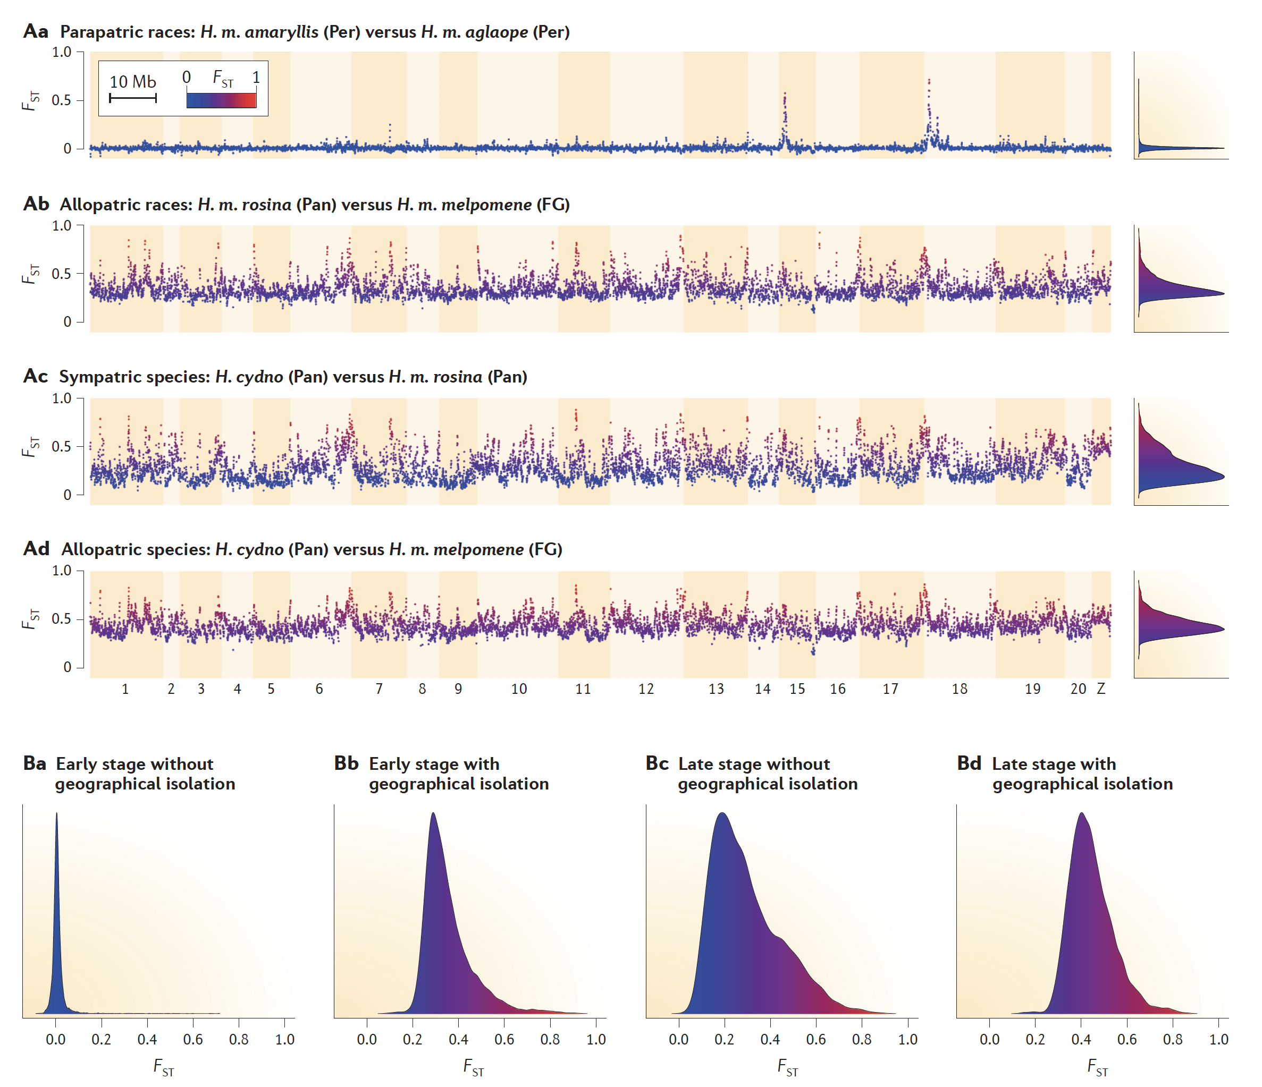
Physical linkage and recombination
Isolating and identifying the loci underpinning local adaptations is generally easier when we can compare populations with different local adaptations that are connected by gene flow.
So that adaptive loci can stand out from a genomic background of low differentiation
Seehausen et al. 2014, Nat. Gen. Rev.

Slide 25
Seehausen et al. 2014, Nat. Gen. Rev.

Slide 26
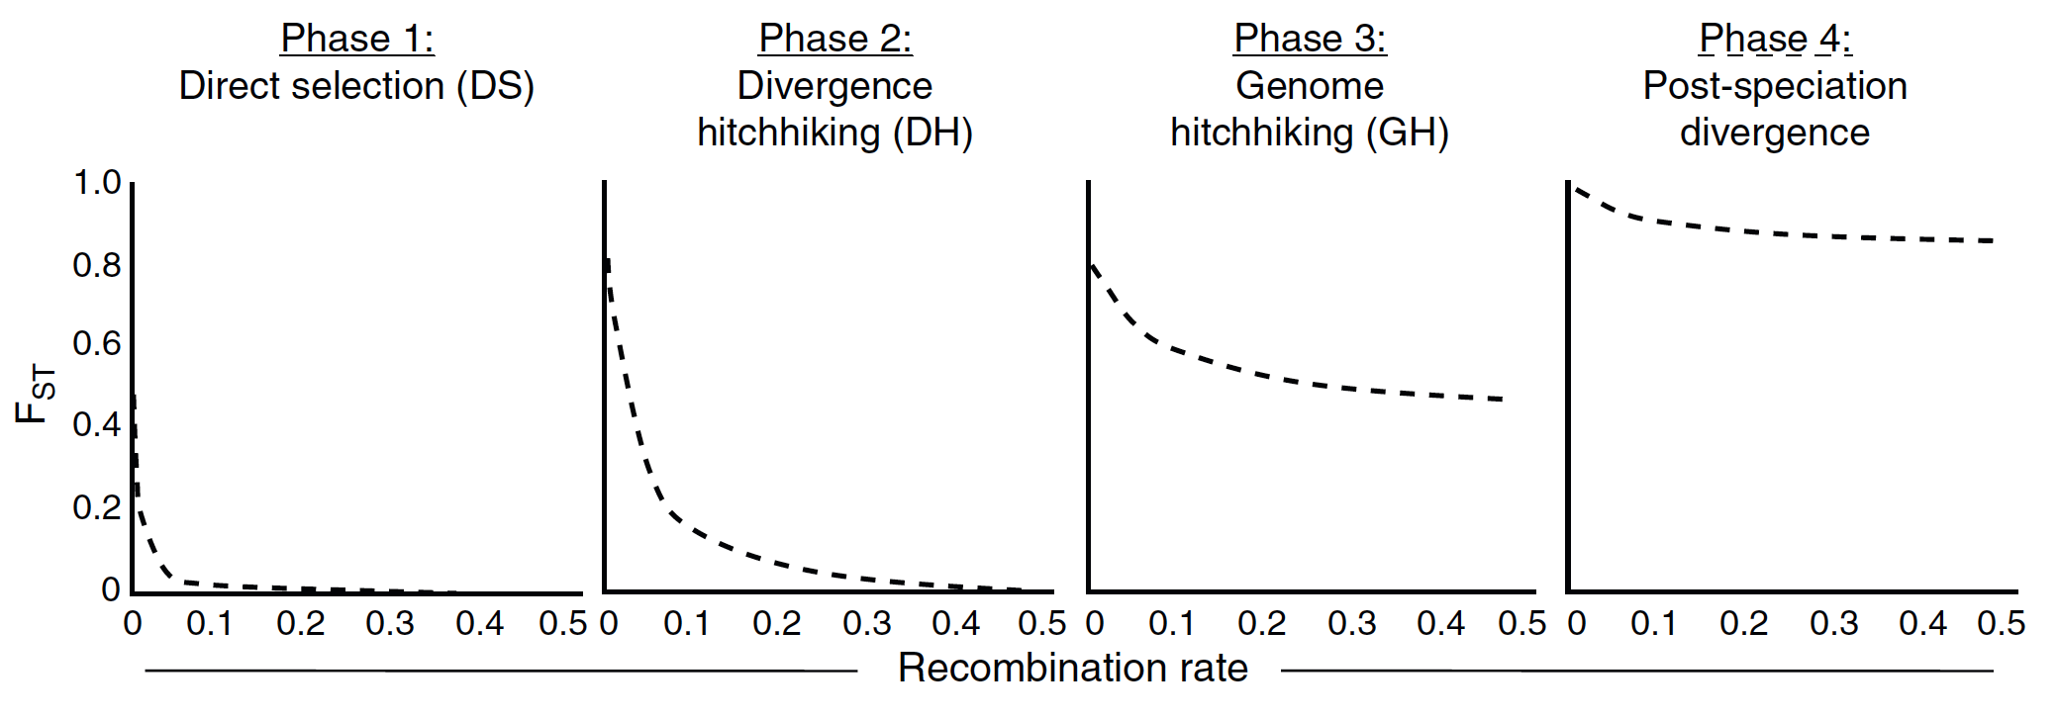
The combination of gene flow and recombination reduces the size of the peak and genome-wide differentiation.
In isolation (no gene flow), divergence at locally adapted loci builds up over long genomic distances.
Feder et al. 2012, TREE

Slide 27
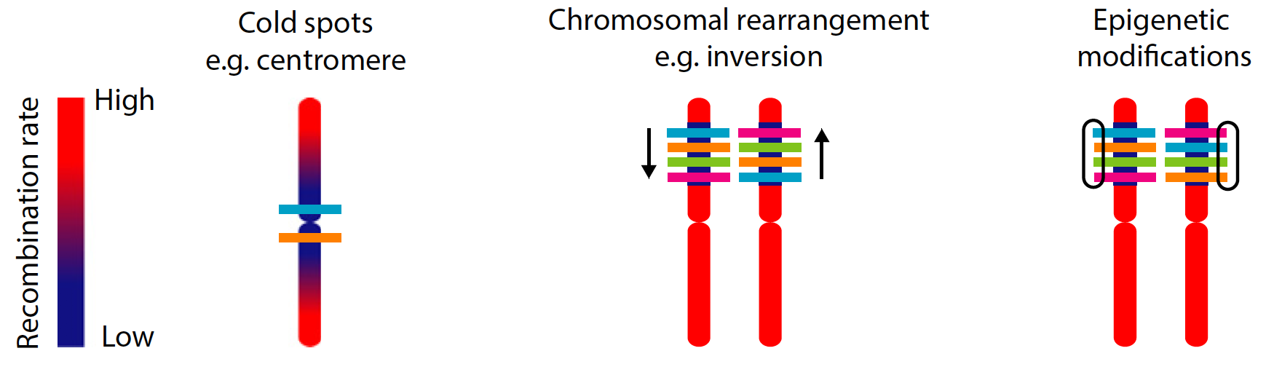
Mechanisms that reduce recombination
Tigano and Friesen 2016, Molecular Ecology

Slide 28
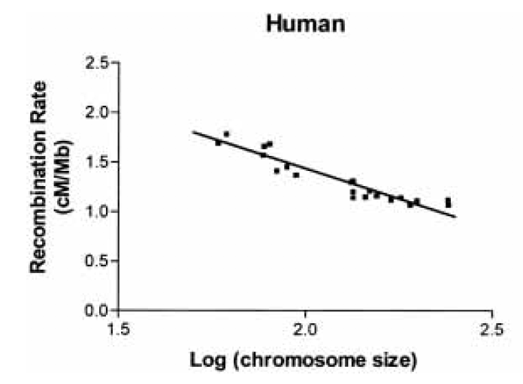
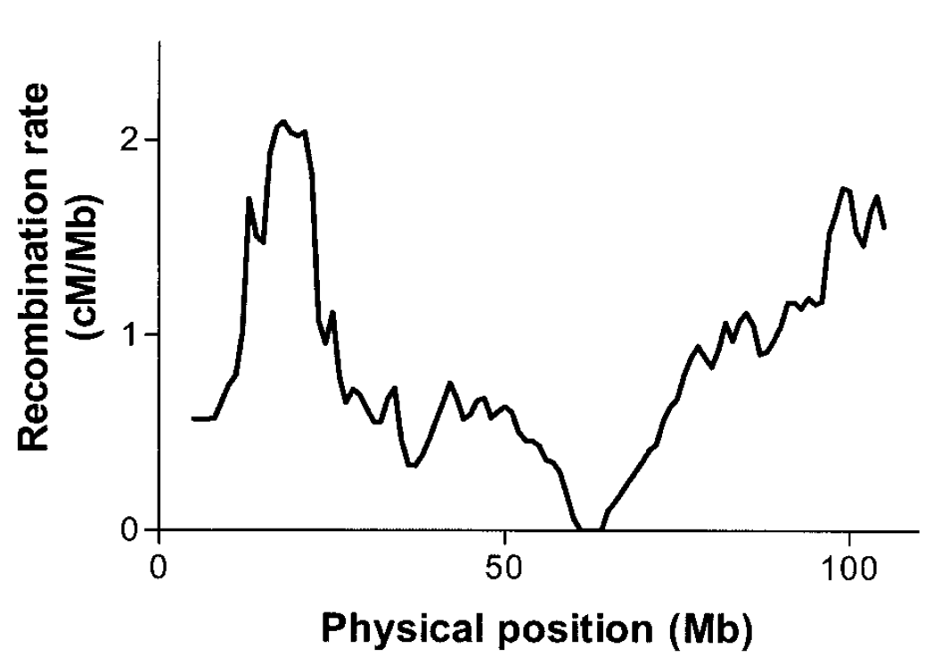
Cold spots of recombination
Recombination rates are not even across the genome.
Recombination rates can vary among chromosomes
…and within chromosomes
Jensen-Seaman et al. 2004, Genome Research

Slide 29
Cold spots of recombination
Recombination rates are not even across the genome.
Recombination rates can vary among chromosomes
…and within chromosomes
Jensen-Seaman et al. 2004, Genome Research

Slide 30
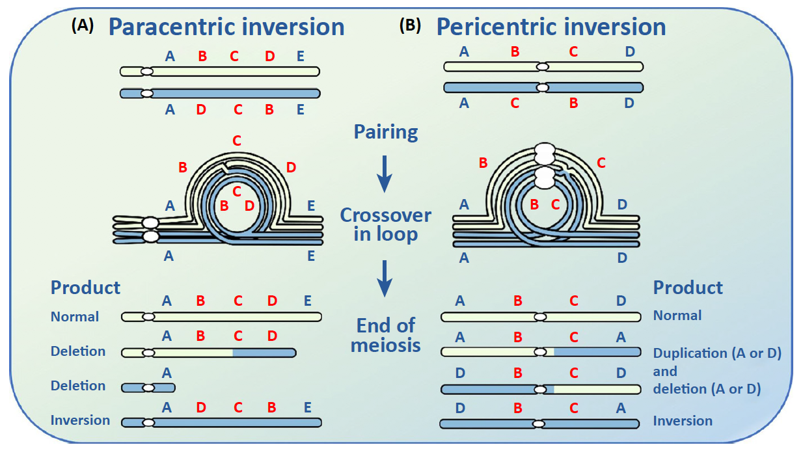
Chromosomal rearrangements
When chromosomes with different structural rearrangements recombine, arrangements different from the parental ones will likely carry deleterious deletions or duplications, thereby suppressing recombination in the areas affected by inversions or other structural variants.
Wellenreuther & Bernatchez 2018, TREE

Slide 31
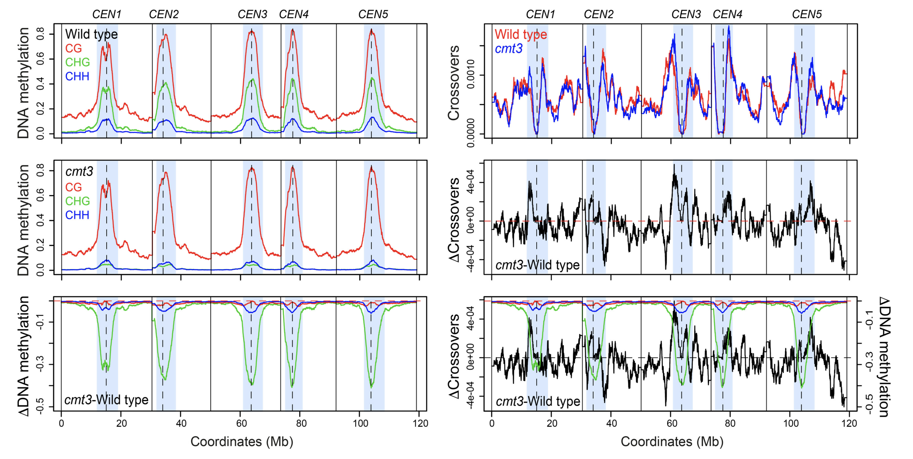
Epigenetic modifications
Methylation can suppress recombination locally, for example around centromeres.
In Arabidopsis thaliana a mutation of the methyltransferase gene cmt3 increases recombination at the centromeres.
Underwood et al. 2020, Genome Research

Slide 32
Genetic architecture of a trait
What we’ve seen so far was based on a single locus scenario, where one locus of large effect underlies the genetic basis of an adaptive trait.
1
One allele at one site increases in frequency due to selection, the others follow due to linked selection even though they are neutral.
F_{ST}
0
Position in the genome

Slide 33
Genetic architecture of a trait
If another nearby locus affects the same (or another adaptive trait), the probability of that beneficial mutation to increase in frequency and establish in the population is higher due to linked selection from the first locus.
1
This leads to the evolution of clusters of adaptive loci showing large peaks of differentiation in the genome.
F_{ST}
0
Position in the genome

Slide 34
Genetic architecture of a trait
On the other hand, the genetic basis of a phenotype could be polygenic, i.e. controlled by many alleles of small effect.
In this case, the signature of selection won’t be as evident as those typical of a selective sweeps.

Slide 35
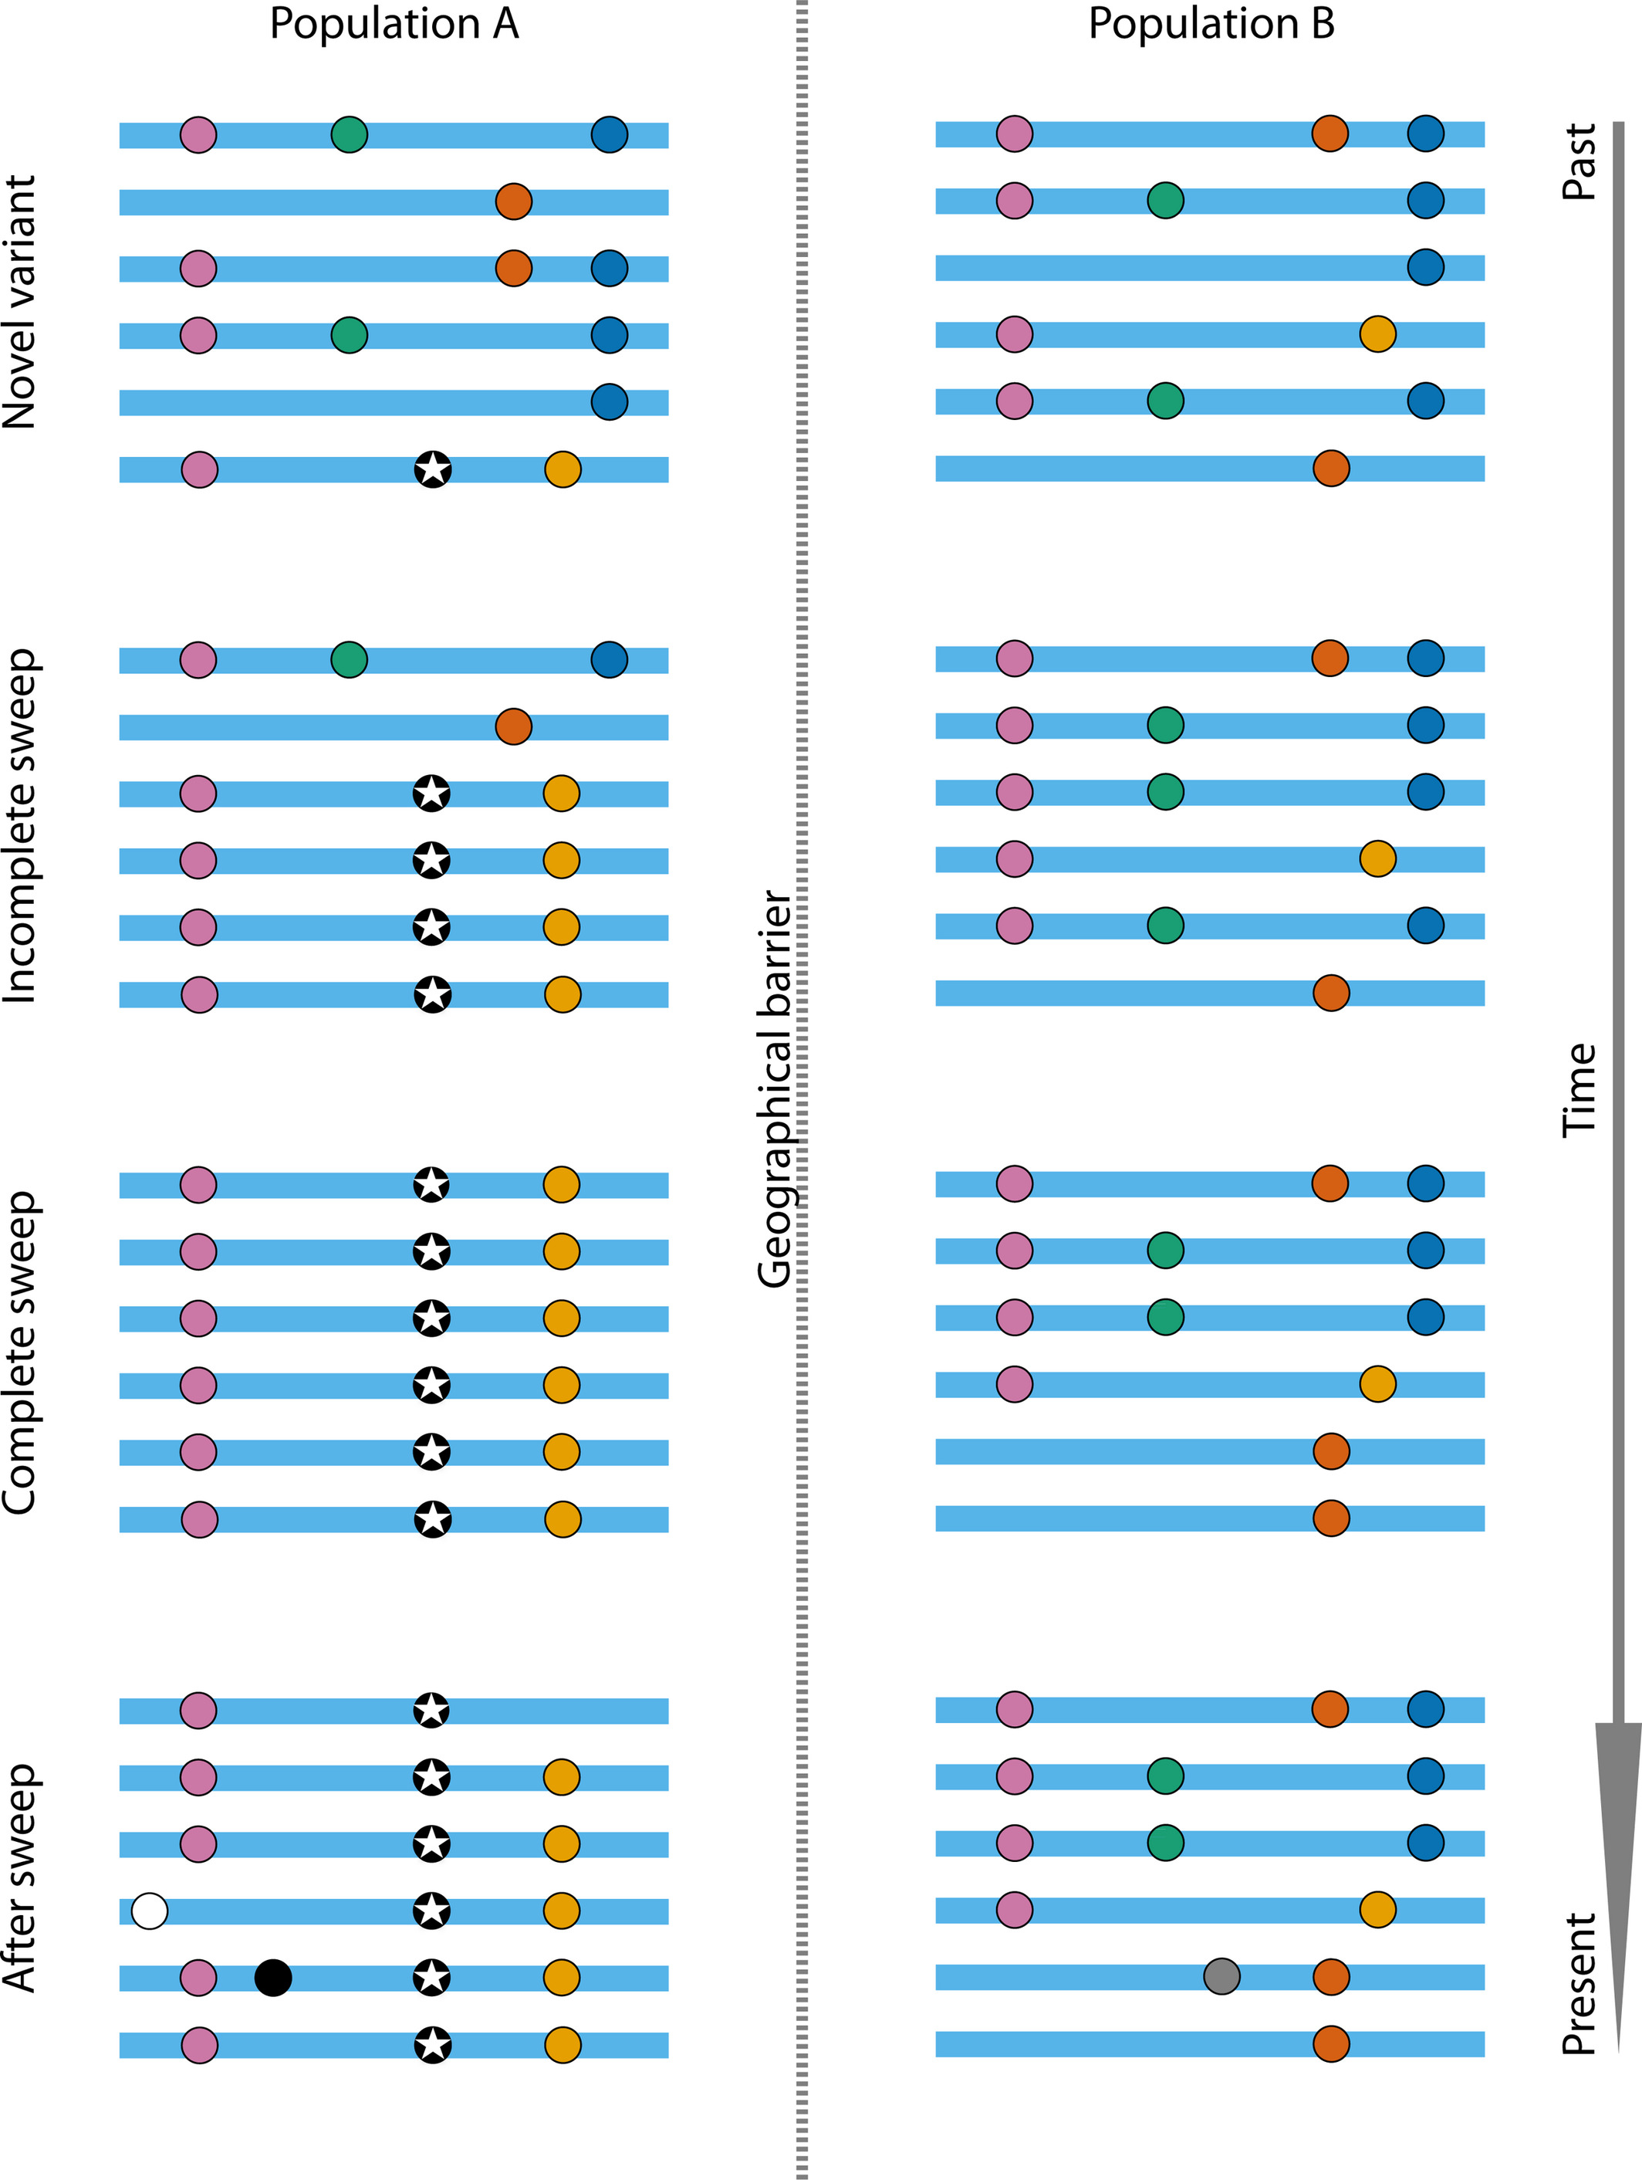
Time
Adaptation is a process. Too early or too late in the process you may not be able to detect the diagnostic signature in the genome.

Slide 36
Factors to consider for your study design
Gene flow
Effective population size
Recombination rate
Genetic architecture
Structural Variation
Population differentiation
Age of local adaptation

Slide 37
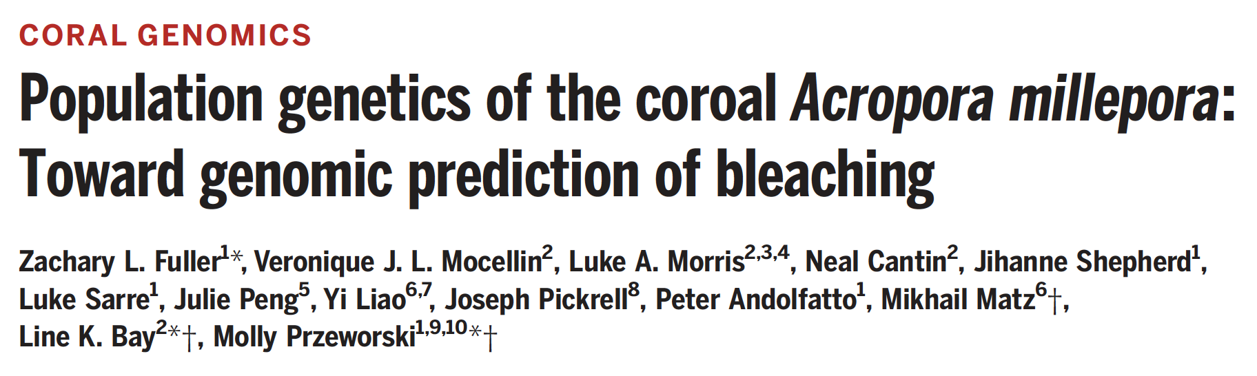
Case study

Slide 38
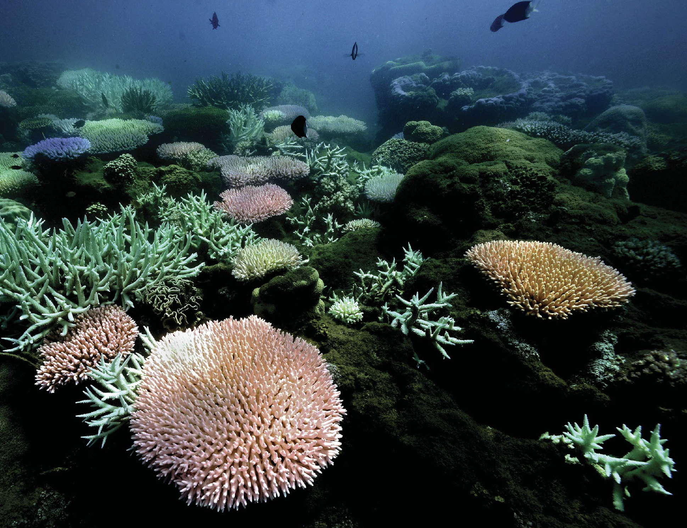
Phenotypic variation in bleaching and heat stress among colonies of Acropora millepora
→ What is the genomic basis and architecture of resistance to bleaching and thermal adaptation?

Slide 39
Sequencing approach
A mixture of few high coverage genomes (n=48) and many more low coverage genome (n=237) for population genomics and GWAS

Slide 40
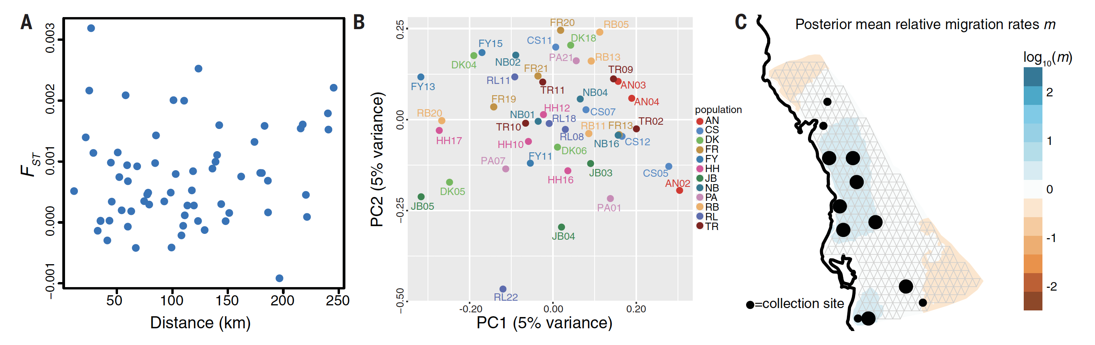
First thing first: population structure
Lack of population structure and high levels of gene flow are promising to isolate loci under selection
No IBD
No pop. structure
High gene flow

Slide 41
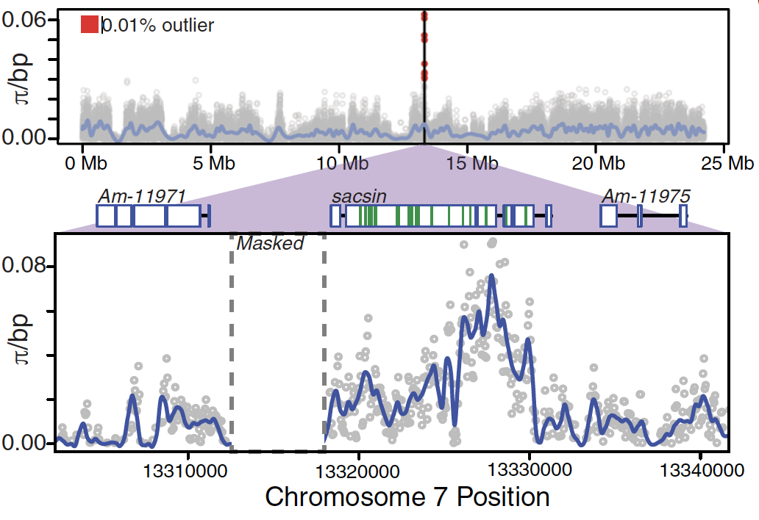
Scan for BALANCING selection
Contrary to natural selection, balancing selection maintains different alleles at intermediate frequencies in the population and is promoted by spatially varying selection.
The signature of balancing selection in high nucleotide diversity π.

Slide 42
Functional annotation of candidate gene
π peak is closest to the gene sacsin, associated with response to heat stress.
→ however, the source of balancing selection is not clear

Slide 43
GWAS (n=213)
Linear mixed model to test for additive effects of SNPs associated with
environmental variables,
population structure,
batch effects collection depth,
proportion of symbiont associated with thermal tolerance.

Slide 44
GWAS (n=213)
Linear mixed model to test for additive effects of SNPs associated with
environmental variables,
population structure,
batch effects collection depth,
proportion of symbiont associated with thermal tolerance.
→ No SNPs above significance threshold suggest polygenic basis of adaptation and low power of study design.

Slide 45
Development of polygenic score (PGS)
Based on LD and effect sizes estimated by GWAS of top SNPs
Model explains 62% of the variation in bleaching.
Genetic basis of resistance to bleaching and thermal stress is highly polygenic

Slide 46
The end!

Slide 47
The process of adaptation
Population A experiences a change in its environment that poses a fitness challenge.
Notes:
New mutations can linger for a while and become part of the pool of standing genetic variation

Slide 48
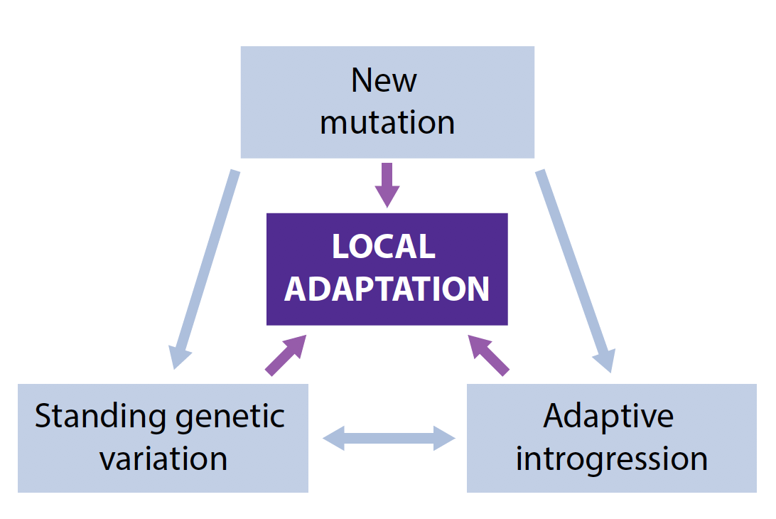
The process of adaptation
The ultimate source of adaptation are new mutations.
Szpak et al. 2019, FEBS Letters; Tigano & Friesen, Molecular Ecology
Notes:
New mutations can linger for a while and become part of the pool of standing genetic variation

Slide 49
The process of adaptation
If the new mutation is beneficial, it will increase in frequency in the population.
Note that the variants on the same haplotype will increase in frequency as well.
Szpak et al. 2019, FEBS Letters

Slide 50
The process of adaptation
The beneficial variant (and other linked variants) will increase to fixation in population A.
Szpak et al. 2019, FEBS Letters

Slide 51
The process of adaptation
After some time, new mutation will be introduced in the population, via either new mutations or gene flow.
Szpak et al. 2019, FEBS Letters

Slide 52
Szpak et al. 2019, FEBS Letters

Slide 53
Signature of a selective sweep
Changes in allele frequencies
Reduction of genetic diversity

